Slide 1
Gradient Descent
Dr. Preeti Rai

Slide 2
Gradient Descent
Gradient Descent is an optimization technique that is used to improve deep learning and neural network-based models by minimizing the cost function.
Gradient descent is an optimization algorithm used to minimize some function by iteratively moving in the direction of steepest descent as defined by the negative of the gradient.

Slide 3
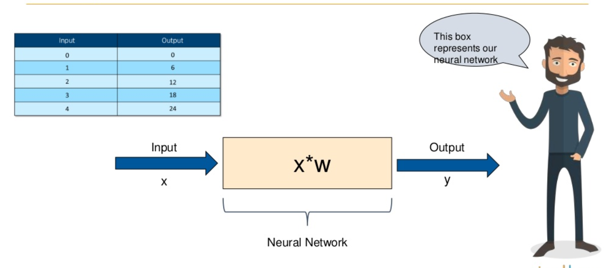
Example

Slide 4
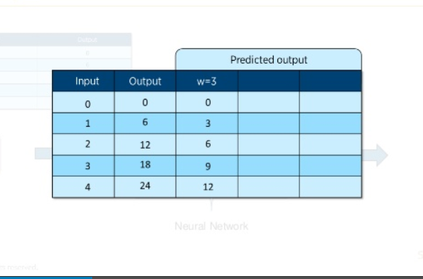

Slide 5
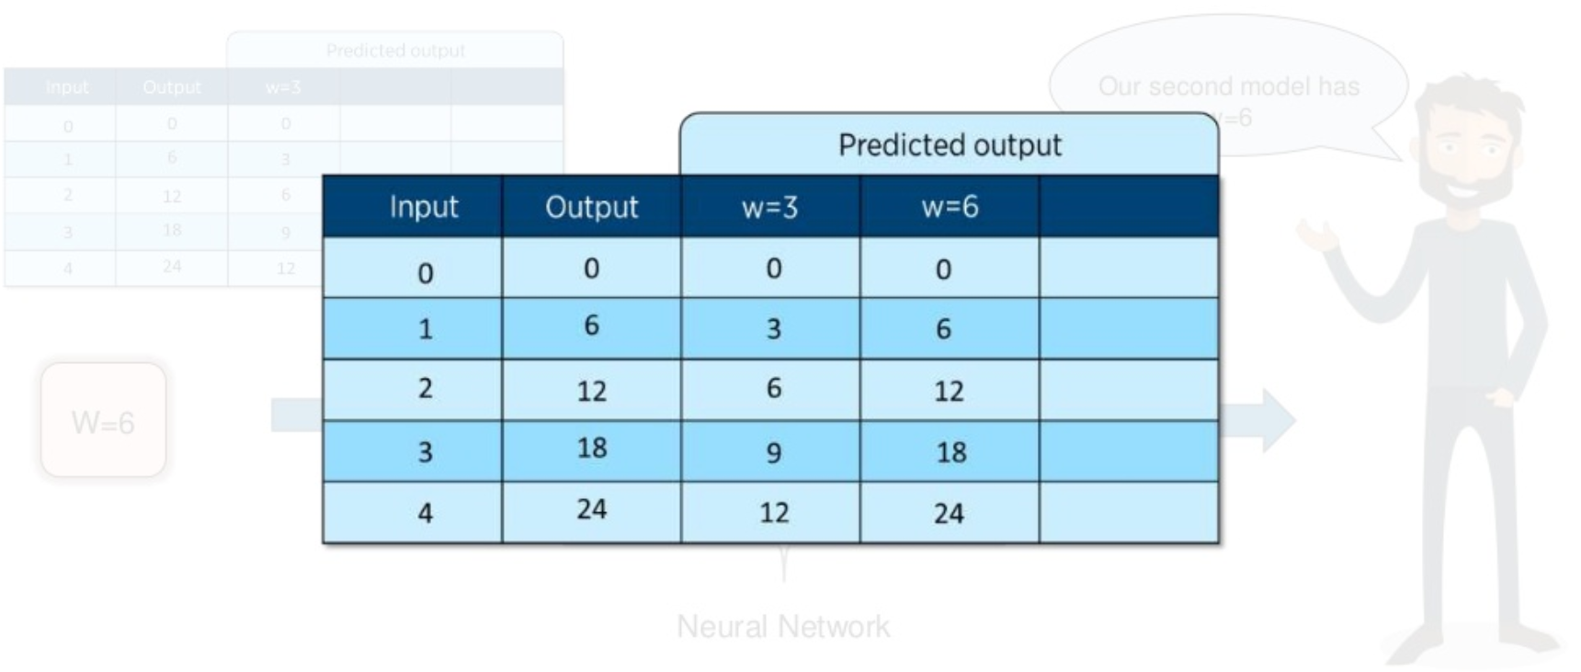

Slide 6
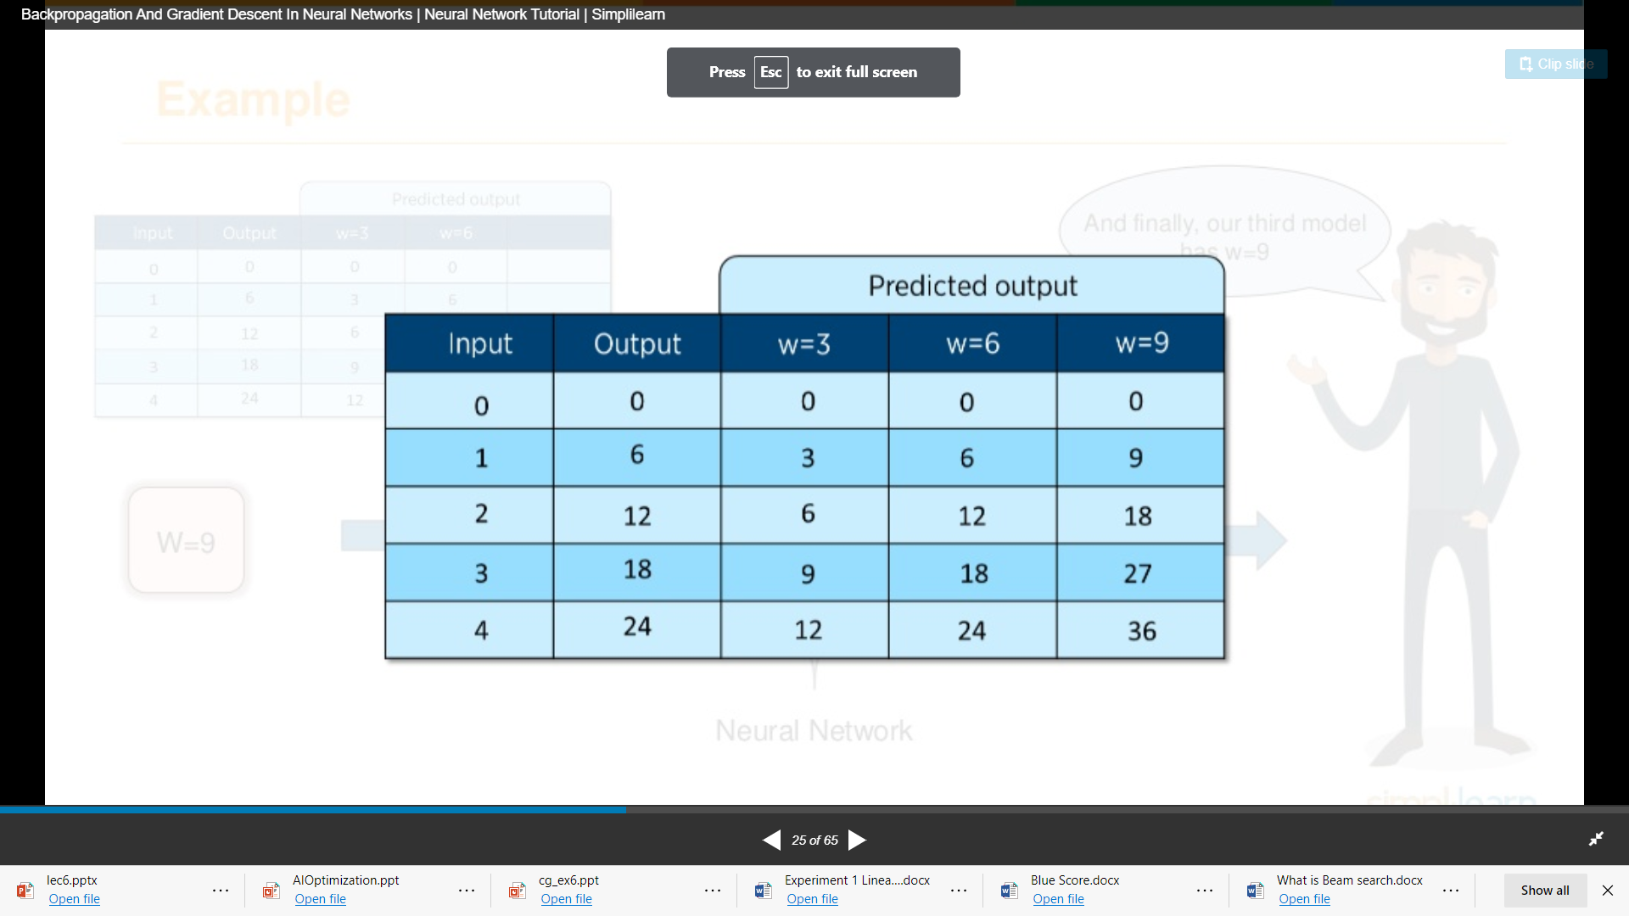

Slide 7
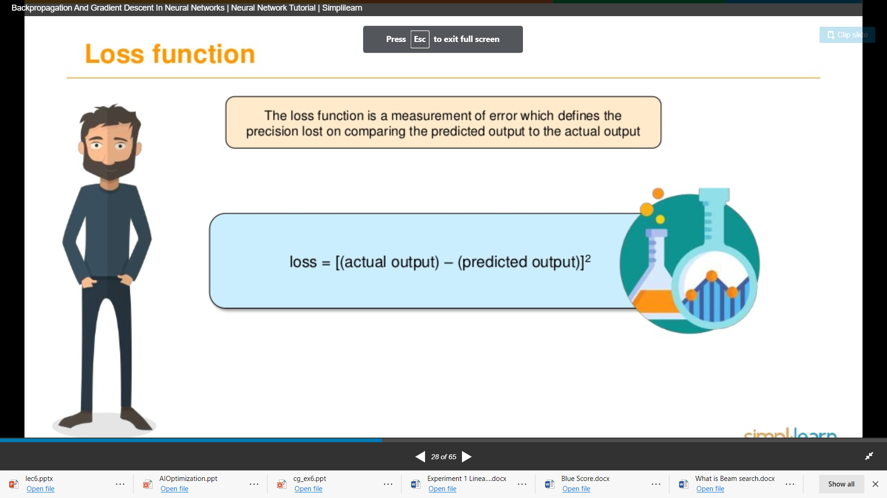

Slide 8
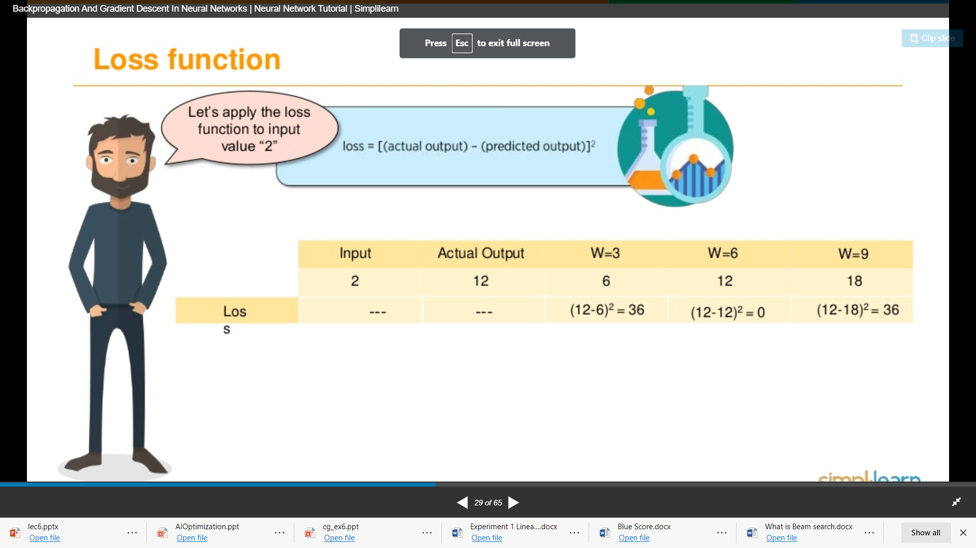

Slide 9
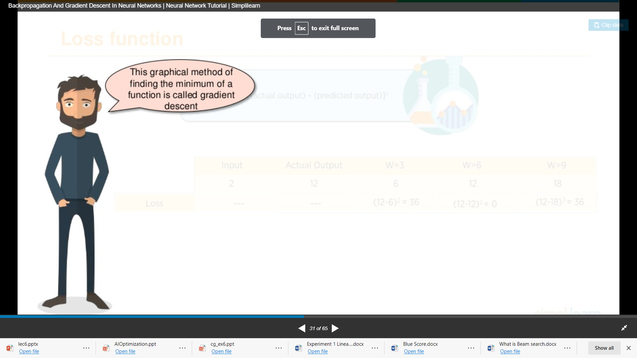
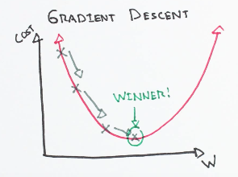

Slide 10
Learning rate
The size of these steps is called the learning rate. With a high learning rate we can cover more ground each step, but we risk overshooting the lowest point since the slope of the hill is constantly changing. With a very low learning rate, we can confidently move in the direction of the negative gradient since we are recalculating it so frequently. A low learning rate is more precise, but calculating the gradient is time-consuming, so it will take us a very long time to get to the bottom. (η)

Slide 11
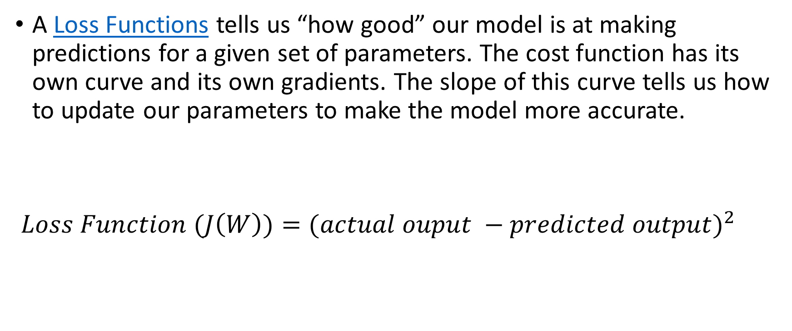
Cost function
A Loss Functions tells us “how good” our model is at making predictions for a given set of parameters. The cost function has its own curve and its own gradients. The slope of this curve tells us how to update our parameters to make the model more accurate.
$Loss Function (J\left(W\right))={(actual ouput −predicted output)}^{2}$

Slide 12
Pseudocode for Gradient Descent
Gradient descent is used to minimize a cost function J(W) parameterized by a model parameters W.
The gradient (or derivative) tells us the incline or slope of the cost function. Hence, to minimize the cost function, we move in the direction opposite to the gradient.
Initialize the weights W randomly.
Calculate the gradients G of cost function w.r.t parameters. This is done using partial differentiation: G = ∂J(W)/∂W. The value of the gradient G depends on the inputs, the current values of the model parameters, and the cost function.
Update the weights by an amount proportional to G, i.e. Wnew = Wold - ηG
Repeat until the cost J(w) stops reducing, or some other pre-defined termination criteria is met.

Slide 13
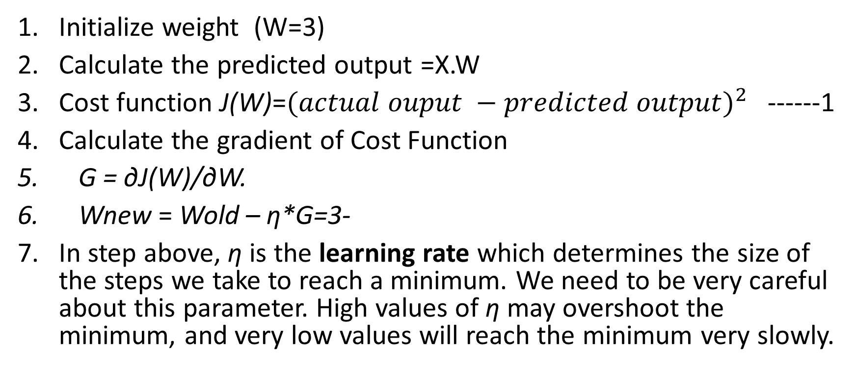
Initialize weight (W=3)
Calculate the predicted output =X.W
Cost function J(W)=${(actual ouput −predicted output)}^{2}$ ------1
Calculate the gradient of Cost Function
G = ∂J(W)/∂W.
Wnew = Wold – η*G=3-
In step above, η is the learning rate which determines the size of the steps we take to reach a minimum. We need to be very careful about this parameter. High values of η may overshoot the minimum, and very low values will reach the minimum very slowly.

Slide 14
In step 6, η is the learning rate which determines the size of the steps we take to reach a minimum. We need to be very careful about this parameter. High values of η may overshoot the minimum, and very low values will reach the minimum very slowly.
A popular choice for the termination criteria is that the cost J(w) stops reducing on a validation dataset.

Slide 15
Vanishing gradient problem
In neural networks during back propagation, each weight receives an update proportional to the partial derivative of the error function. In some cases, this derivative term is so small that it makes updates very small. Especially in deep layers of the neural network, the update is obtained by multiplication of various partial derivatives.
If these partial derivatives are very small then the overall update becomes very small and approaches zero. In such a case, weights will not be able to update and hence there will be slow or no convergence. This problem is known as the Vanishing gradient problem.

Slide 16
Exploding gradient problem.
Similarly, if the derivative term is very large then updates will also be very large. In such a case, the algorithm will overshoot the minimum and won’t be able to converge. This problem is known as the Exploding gradient problem.
There are various methods to avoid these problems. Choosing the appropriate activation function is one of the them.

Slide 17
Gradient Descent Rule
w_{t+1} = w_{t} − η∇w_{t}
b_{t+1} = b_{t} − η∇b_{t}
where, ∇w_{t} = ∂J(w,b)/∂W. at w = w_{t}, b = b_{t} ,
∇b_{t} = ∂L (w, b) ∂b at w = w_{t}, b = b_{t}
1

Slide 18
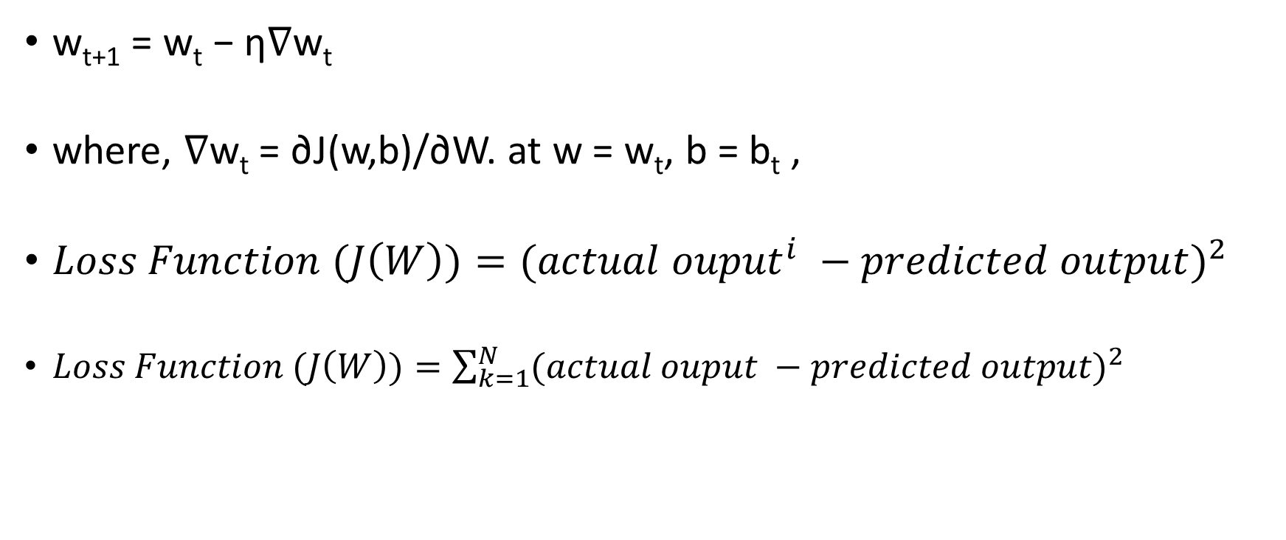
Gradient Descent Rule
w_{t+1} = w_{t} − η∇w_{t}
where, ∇w_{t} = ∂J(w,b)/∂W. at w = w_{t}, b = b_{t} ,
$Loss Function (J\left(W\right))={({actual ouput}^{i} −predicted output)}^{2}$
$Loss Function (J\left(W\right))=\sum_{k=1}^{N}{{(actual ouput −predicted output)}^{2}}$
1

Slide 19
Typically, the value of the learning rate is chosen manually. We usually start with a small value such as 0.1, 0.01 or 0.001 and adapt it based on whether the cost function is reducing very slowly (increase learning rate) or is exploding / being erratic (decrease learning rate).

Slide 20
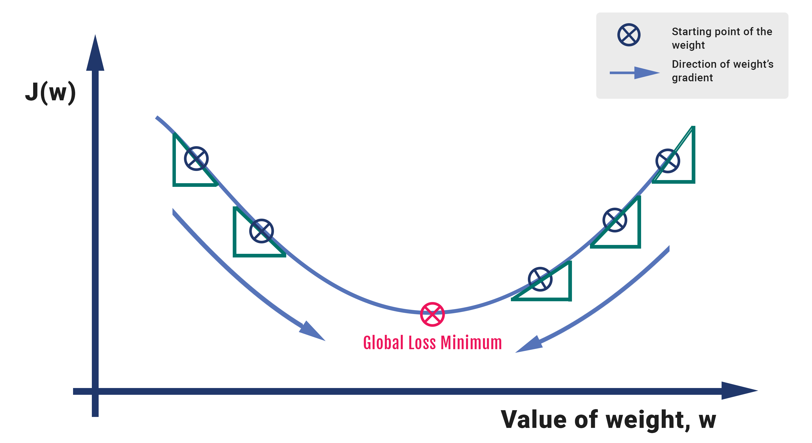

Slide 21
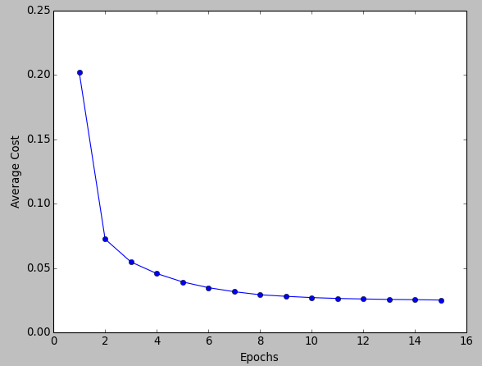

Slide 22
Variants of Gradient Descent
There are multiple variants of gradient descent, depending on how much of the data is being used to calculate the gradient.
The main reason for these variations is computational efficiency. A dataset may have millions of data points, and calculating the gradient over the entire dataset can be computationally expensive.
Batch gradient descent computes the gradient of the cost function w.r.t to parameter W for entire training data. Since we need to calculate the gradients for the whole dataset to perform one parameter update, batch gradient descent can be very slow.

Slide 23
Stochastic gradient descent (SGD)
computes the gradient for each update using a single training data point x_i (chosen at random). The idea is that the gradient calculated this way is a stochastic approximation to the gradient calculated using the entire training data. Each update is now much faster to calculate than in batch gradient descent, and over many updates, we will head in the same general direction.
SGD can be used for larger datasets. It converges faster when the dataset is large as it causes updates to the parameters more frequently.

Slide 24
Stochastic gradient descent (SGD)
Take an example
Feed it to Neural Network
Calculate it’s gradient
Use the gradient we calculated in step 3 to update the weights
Repeat steps 1–4 for all the examples in training dataset
Since we are considering just one example at a time the cost will fluctuate over the training examples and it will not necessarily decrease. But in the long run, you will see the cost decreasing with fluctuations.

Slide 25
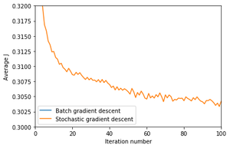
Stochastic gradient descent (SGD)

Slide 26
mini-batch gradient descent
In mini-batch gradient descent, we calculate the gradient for each small mini-batch of training data. That is, we first divide the training data into small batches (say M samples per batch). We perform one update per mini-batch. M is usually in the range 30–500, depending on the problem. Usually mini-batch GD is used because computing infrastructure — compilers, CPUs, GPUs — are often optimized for performing vector additions and vector multiplications.
Of these, SGD and mini-batch GD are most popular.

Slide 27
mini-batch gradient descent
So, after creating the mini-batches of fixed size, we do the following steps in one epoch:
Pick a mini-batch
Feed it to Neural Network
Calculate the mean gradient of the mini-batch
Use the mean gradient we calculated in step 3 to update the weights
Repeat steps 1–4 for the mini-batches we created

Slide 28
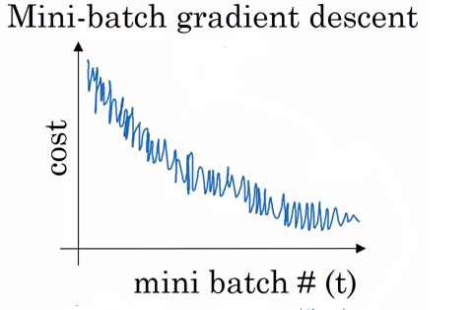
mini-batch gradient descent

Slide 29
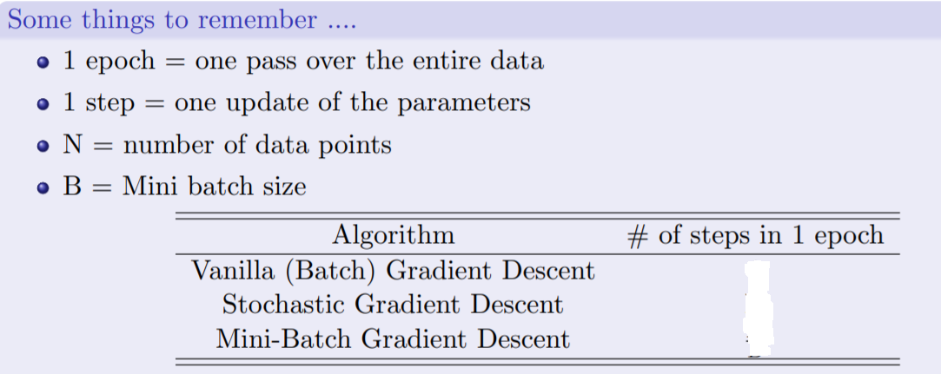
1
N
N/B

Slide 30
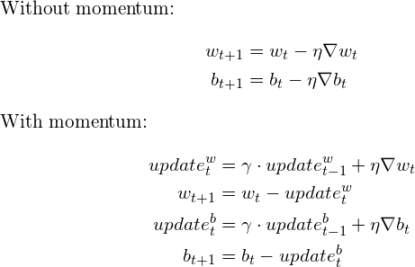
Momentum-Based Gradient Descent
If I am repeatedly being asked to move in the same direction then I should probably gain some confidence and start taking
bigger steps in that direction. Just as a ball gains momentum while rolling down a slope.
We accommodate the momentum concept in the gradient update rule as follows:

Slide 31
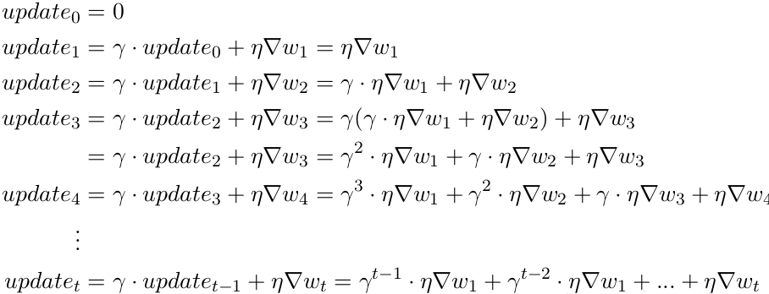
In addition to the current update, we also look at the history of updates. I encourage you to take your time to process the new update rule and try and put it on paper how the update term changes in every step. Or keep reading. Breaking it down we get
You can see that the current update is proportional to not just the present gradient but also gradients of previous steps, although their contribution reduces every time step by γ(gamma) times. And that is how we boost the magnitude of the update at gentle regions.

Slide 33
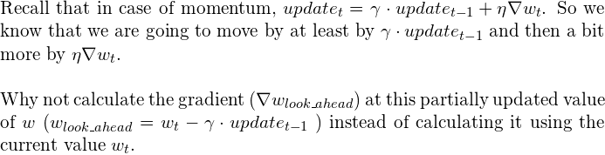
Nesterov Accelerated Gradient Descent

Slide 34
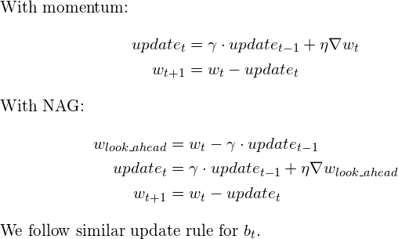
The NAG Update Rule

Slide 35
The NAG Update Rule
in NAG’s case, every update happens in two steps — first, a partial update, where we get to the look_ahead point and then the final update

Slide 37
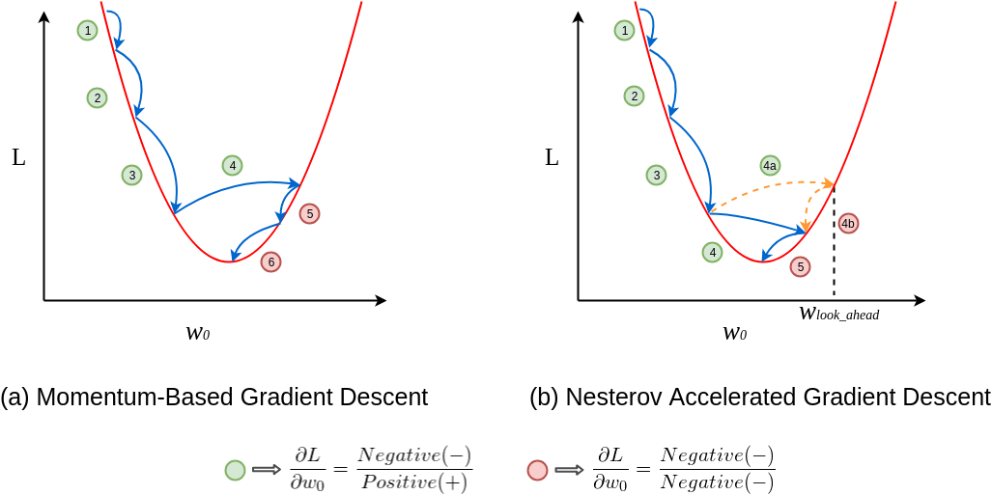

Slide 38
Optimization basically means getting the optimal output for your problem.

Slide 39
AdaGrad: Parameters Gets Different Learning Rates
Adaptive Gradients (AdaGrad) provides us with a simple approach, for changing the learning rate over time. This is important for adapting to the differences in datasets, since we can get small or large updates, according to how the learning rate is defined.
Adagrad is an optimizer with parameter-specific learning rates, which are adapted relative to how frequently a parameter gets updated during training. The more updates a parameter receives, the smaller the learning rate.
Let's go for a top to bottom approach; here is the equation:

Slide 40
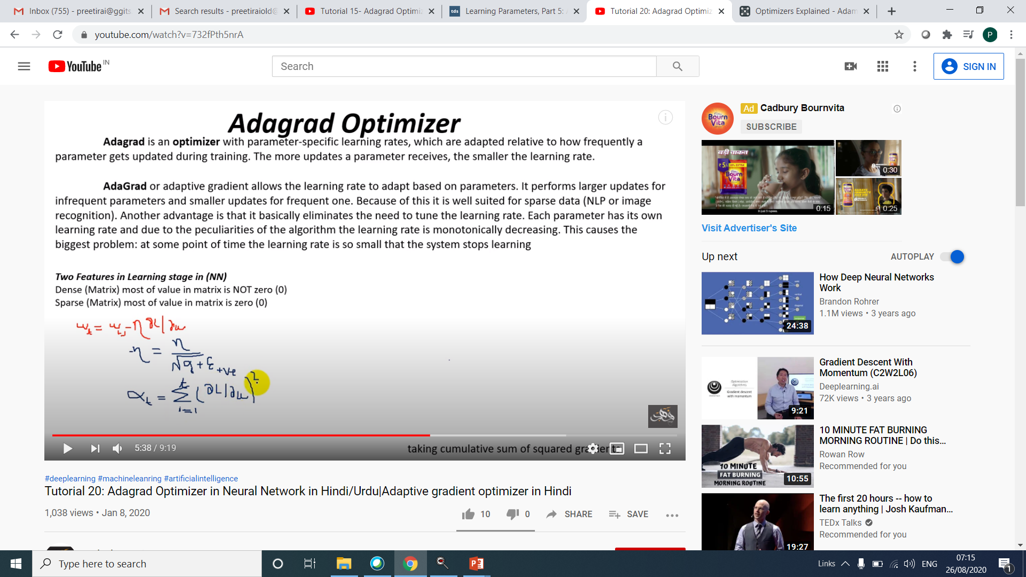

Slide 41
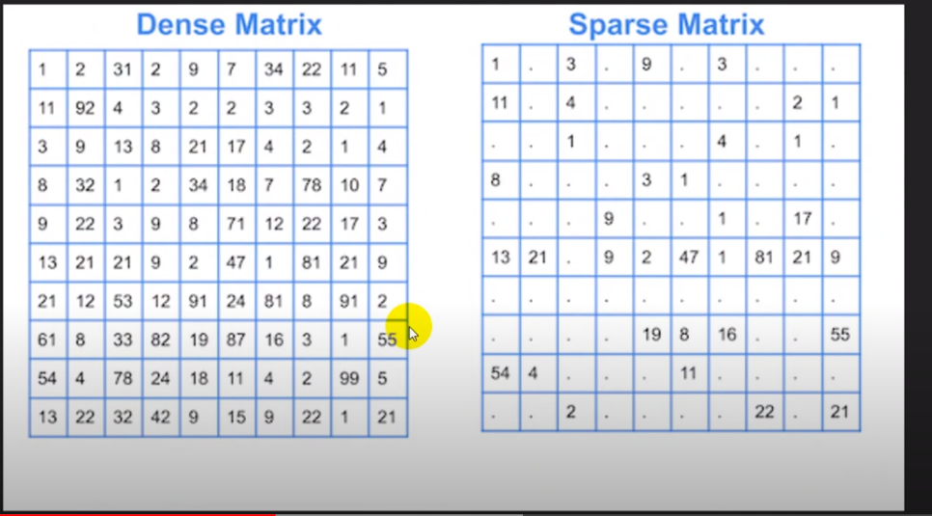

Slide 42
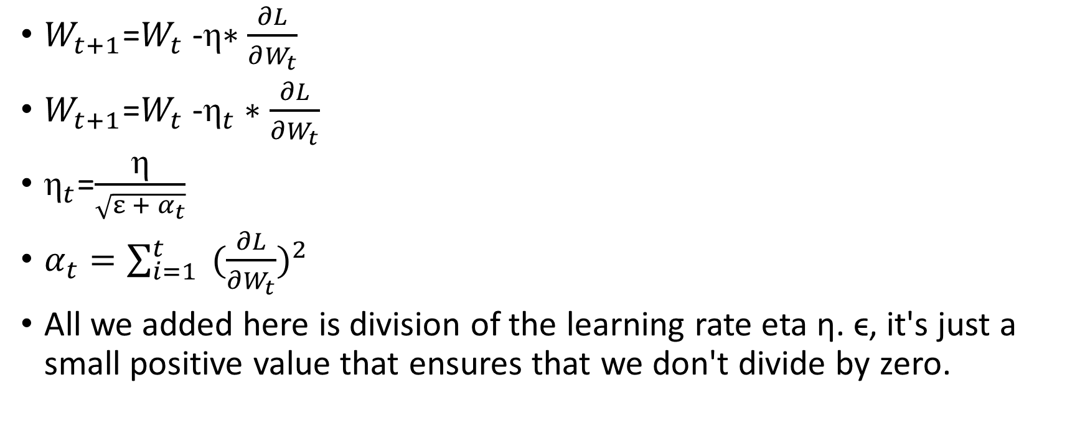
AdaGrad
$W_{t+1}$=$W_{t}$ -η$∗\frac{∂L}{∂W_{t}}$
$W_{t+1}$=$W_{t}$ -${\text{η}}_{t}∗\frac{∂L}{∂W_{t}}$
${\text{η}}_{t}$=$\frac{\text{η}}{\sqrt{ε + α_{t}}}$
$α_{t}=\sum_{i=1}^{t}{ {(\frac{∂L}{∂W_{t}})}^{2} }$
All we added here is division of the learning rate eta η. ϵ, it's just a small positive value that ensures that we don't divide by zero.

Slide 43
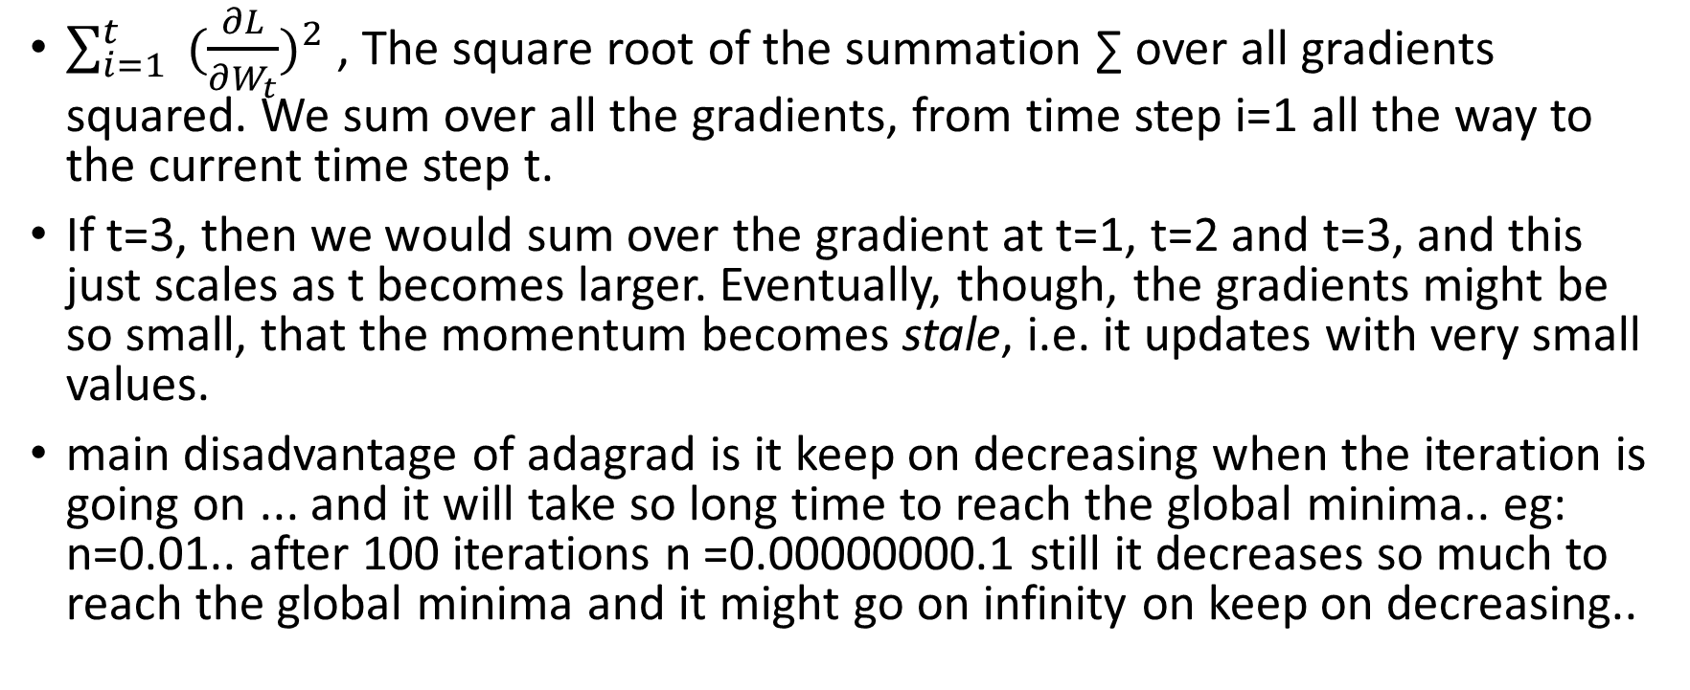
$\sum_{i=1}^{t}{ {(\frac{∂L}{∂W_{t}})}^{2} }$, The square root of the summation ∑ over all gradients squared. We sum over all the gradients, from time step i=1 all the way to the current time step t.
If t=3, then we would sum over the gradient at t=1, t=2 and t=3, and this just scales as t becomes larger. Eventually, though, the gradients might be so small, that the momentum becomes stale, i.e. it updates with very small values.
main disadvantage of adagrad is it keep on decreasing when the iteration is going on ... and it will take so long time to reach the global minima.. eg: n=0.01.. after 100 iterations n =0.00000000.1 still it decreases so much to reach the global minima and it might go on infinity on keep on decreasing..

Slide 44
RMSprop
Root Mean Squared Propagation (RMSprop) is very close to Adagrad, except for it does not provide the sum of the gradients, but instead an exponentially decaying average. This decaying average is realized through combining the Momentum algorithm and Adagrad algorithm, with a new term.
An important property of RMSprop is that we are not restricted to just the sum of the past gradients, but instead we are more restricted to gradients for the recent time steps. This means that RMSprop changes the learning rate slower than Adagrad, but still reaps the benefits of converging relatively fast – as has been shown

